Slide 1
Parcel Identification & ALTA Surveys: What you need to know
November 19, 2025
Presented by:
Wendell Sommers
Brent Oswald
© 2025 CREtelligent Inc.
Notes:
Before we begin I am going to hand things over to gary for some quick housekeeping items…

Slide 2

Recap – September Webinar
ALTA/NSPS 101 – What is a survey; why do we need them?
Understanding the purpose and scope of your project
Lender and title considerations
Engineering vs Transactional surveys
Collecting necessary prior due diligence
Timing and expectations
We’ll share a recording of the first session
in our follow-up email!
© 2025 CREtelligent Inc.

Slide 3
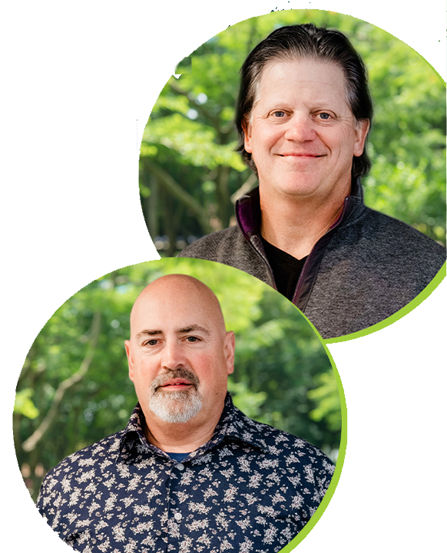
Today’s agenda
Why do commercial properties have more than one parcel?
Locating the primary parcel
How to locate incorrect addresses or no addresses
Determining secondary parcels
Beneficial easements
Why is all of this important?
SPEAKERS
Wendell
Sommers
Brent
Oswald
© 2025 CREtelligent Inc.

Slide 4
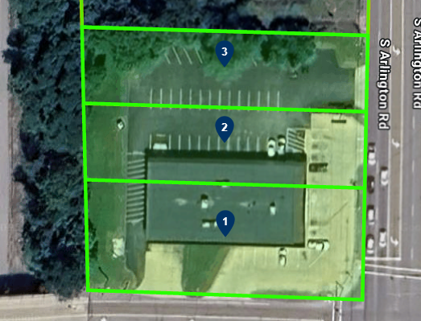
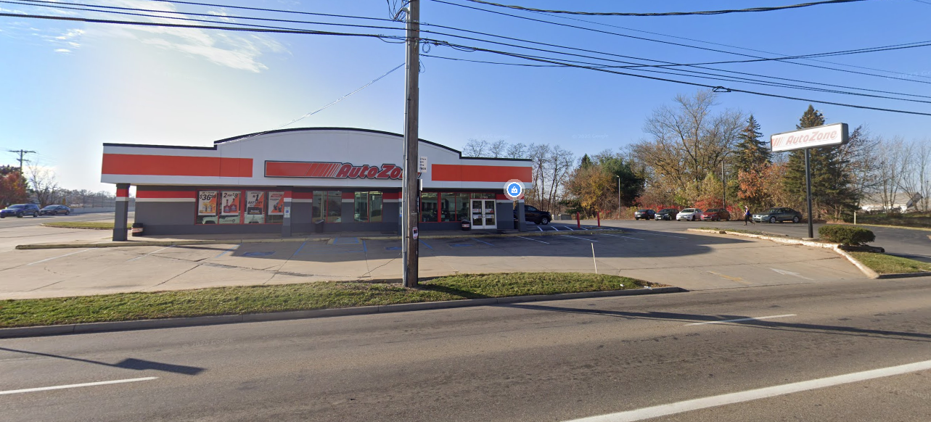
Commercial properties explained
  Why do commercial properties have more than one parcel?
Municipalities allow buildings to be built across parcel lines
Most common in older areas
Lot combination not required

Slide 5
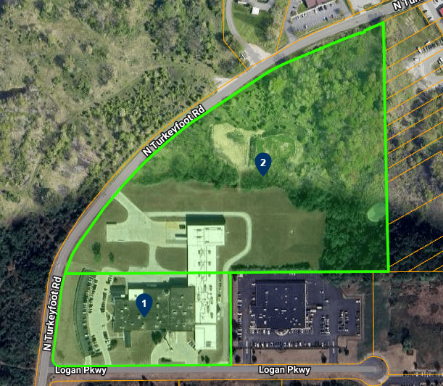
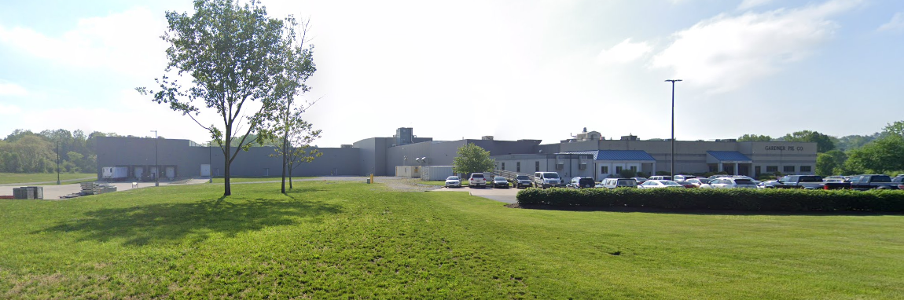
Commercial properties explained
  Why do commercial properties have more than one parcel?
Business has expanded
Parking or storage needed
Opportunistic

Slide 6
Locating the primary parcel
Best scenario-address just works on a single parcel
Address doesn’t work
    a) Doesn’t match assessor
    b) Transposed address
    There is no address
    a) Cell phone tower
    b) Vacant land
    c) Parcels not yet created/recorded
    Confirm use matches client information

Slide 7
Locating secondary parcels
Review adjacent parcels for same or similar ownership
Confirm Business Activity Extents (Aerial Review)
a) Fences
b) Drive lanes
c) Outdoor storage
d) Activities/buildings that appear to cross parcel lines
Verify Parking-customers and employees
Beneficial easements

Slide 8
What do I do with this information?
Importance of a special site description
a) If you questioned something, so will “they”
b) Clearly explain to ensure no errors
c) If you don’t know, they won’t know
Go back to the source if anything can’t be resolved
© 2025 CREtelligent Inc.

Slide 9


QUESTIONS?
Watch for our upcoming webinars:
February: Understanding recent changes to the ALTA Standards
© 2025 CREtelligent Inc.

Slide 10

b.oswald@cretelligent.com
w.sommers@cretelligent.com
www.cretelligent.com 866.901.1702

