Slide 1
Preparing for your
ALTA/NSPS Land Title Survey Project
September 25, 2025
Presented by:
Wendell Sommers
Brent Oswald
Moderator:
Jack Stanton
© 2025 CREtelligent Inc.
Notes:
Before we begin I am going to hand things over to gary for some quick housekeeping items…

Slide 2



MODERATOR
Today’s Agenda
Introduction
ALTA/NSPS 101 – What is a survey; why do we need them?
Understanding the purpose and scope of your project
Engineering vs Transactional surveys
Collecting necessary prior due diligence
Parcel relationships and survey boundaries
Lender and title considerations
Timing and expectations
Conclusions
Q&A
Jack Stanton
SPEAKERS
Wendell
Sommers
Brent
Oswald
© 2025 CREtelligent Inc.

Slide 3
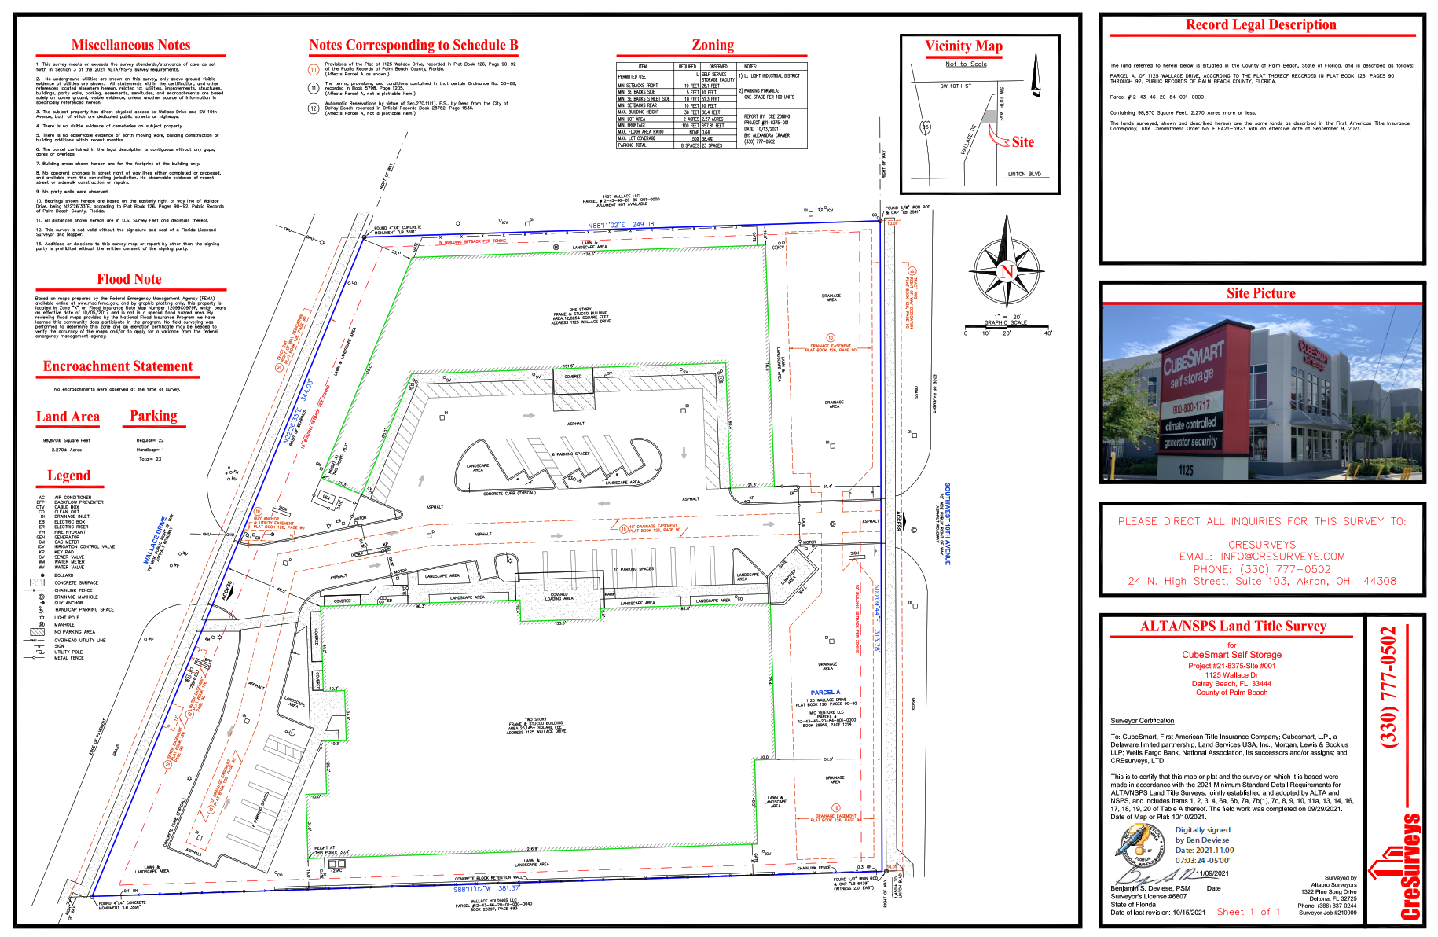
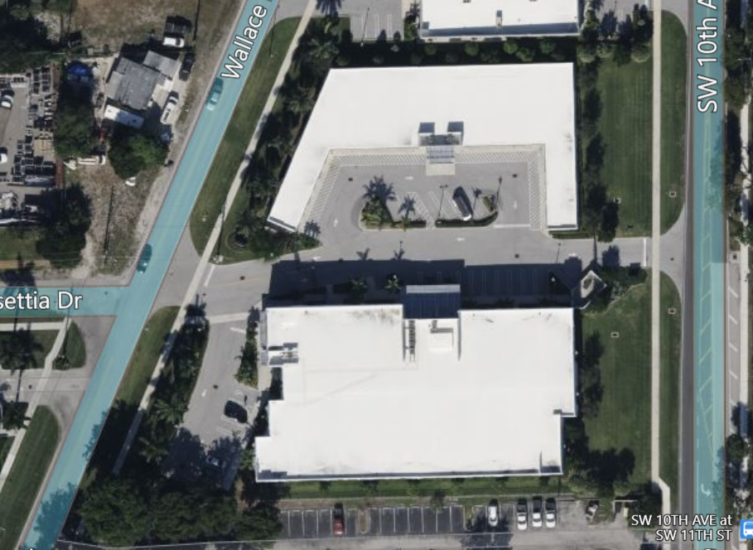
What is an ALTA Land Title Survey?
Site conditions with title overlay
Identifies improvements, utilities, easements, encroachments, & other features that impact a property's title, use…
…and potential value!
Why are they needed?

Slide 4
What is an ALTA Land Title Survey?
Site conditions with title overlay
Identifies improvements, utilities, easements, encroachments, & other features that impact a property's title, use…
…and potential value!
Why are they needed?

Slide 5
Purpose & Scope
What is the intent of the survey?
                Transactional needs
                Development planning
                Design
                County submittal requirements
Property type should guide your requirements
                What is important to ensure this business can operate?
                Example: picking up beneficial easements
                Access to courtyards and other non-structural areas
© 2025 CREtelligent Inc.

Slide 6
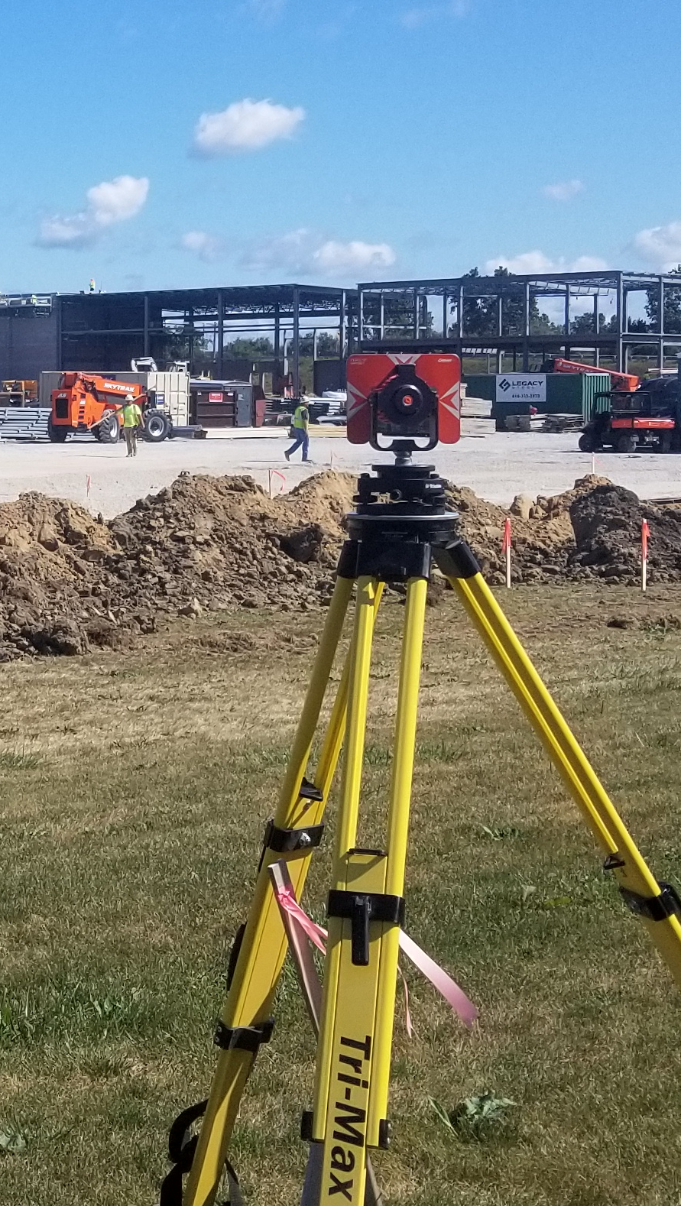
Development Grade vs Transactional
ALTA surveys with the same table A items can be very different
Price and timing typically are most important for transactions
High levels of accuracy are needed for engineering
Examples
Details scope of work required for engineering grade
© 2025 CREtelligent Inc.

Slide 7

Lender & Title Considerations
Understanding the lender’s specific requirements
    Gather requirements from your primary and secondary lenders
    Ensures you won’t need an additional site visit and survey if you switch lenders partway through the transaction
The importance of the Title Commitment
      Identifies exceptions and matters affecting the property
      Delays caused by incomplete or late title commitments
Significance of Certified Parties
© 2025 CREtelligent Inc.

Slide 8
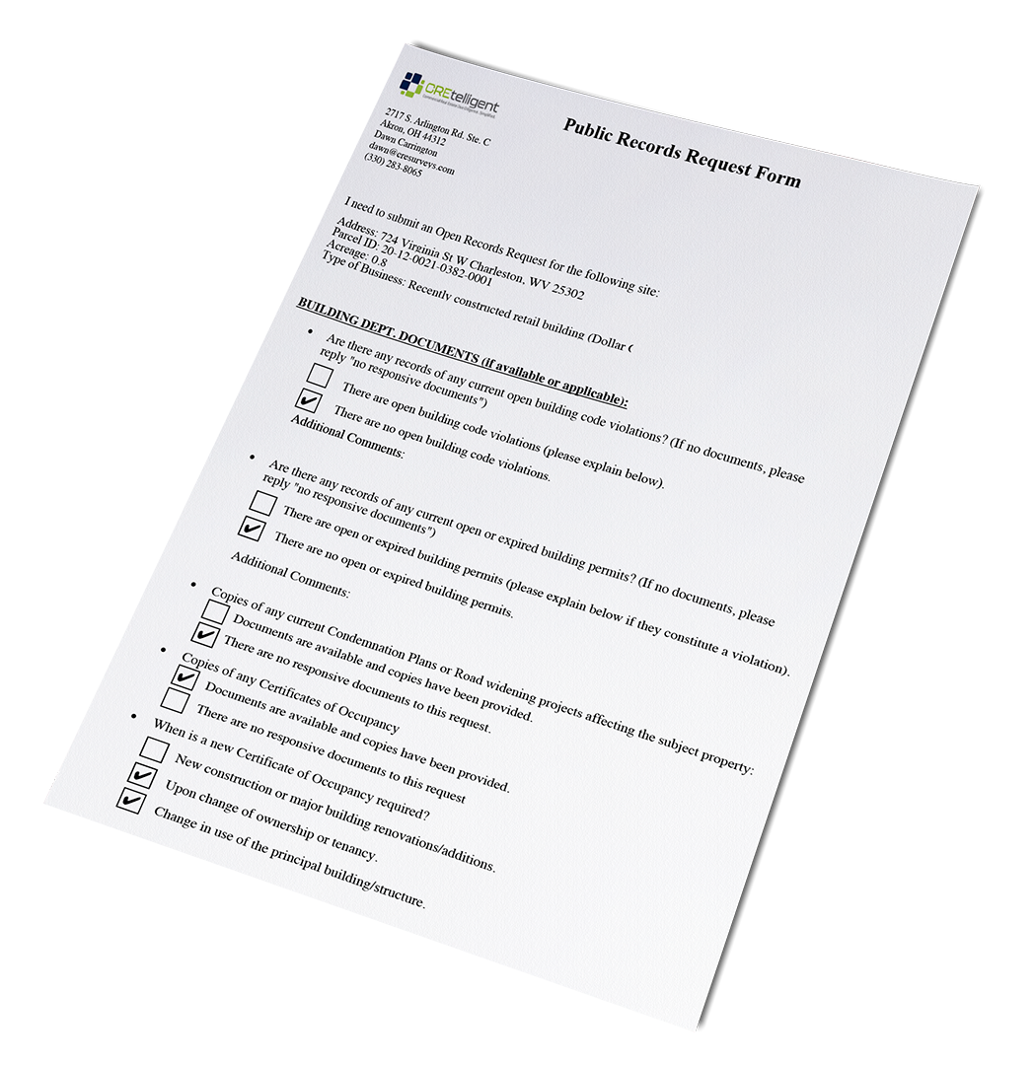
Gathering Documentation
Prior due diligence documents - Why is this important?
Deeds are helpful, especially if a prior title commitment and/or survey is not readily available.
Supporting reports
  Zoning reports
  Private utility locations
© 2025 CREtelligent Inc.

Slide 9
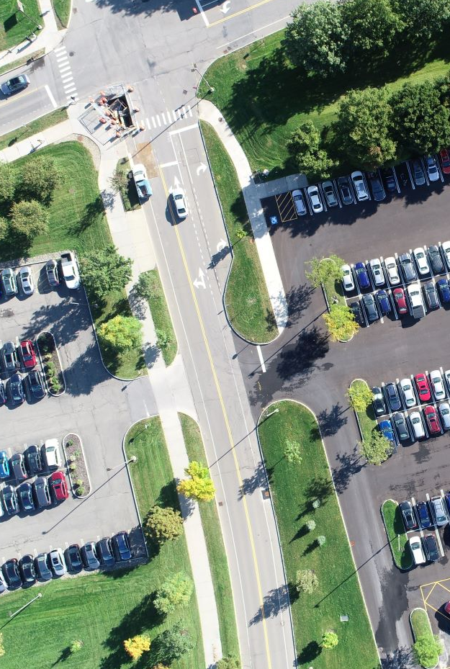
Understanding the Property
Most commercial properties are made up of multiple parcels
Parcel numbers, addresses, facility names
Typically, these parcels have the same ownership. But not always!
Confirm that all business operations are contained within the outer boundary and all parking is accounted for
Identify facility types (current & proposed) to define scope and site access
Do we need a single survey or separate surveys? Why?
© 2025 CREtelligent Inc.

Slide 10
Timing and Expectations
Typical turnaround times
Factors that delay a project
“Top Five” reasons
#1 Late title commitments
#2 Scope changes
#3 Site access issues
#4 Unclear legal descriptions
5# Weather/seasonal conditions
Importance of early preparation to avoid last-minute issues
© 2025 CREtelligent Inc.

Slide 11

Conclusions
Critical components to a successful survey project:
Defining the scope
Identifying all parcels/sites included
Collecting other documents, especially title
commitment
Being prepared helps keep transactions on track,
and saves time and money!
© 2025 CREtelligent Inc.

Slide 12


QUESTIONS?
Watch for our upcoming webinars:
October: Parcel research & identification made easy
February: Understanding recent changes to the ALTA Standards
© 2025 CREtelligent Inc.

Slide 13

b.oswald@cretelligent.com
w.sommers@cretelligent.com
www.cretelligent.com 866.901.1702

