Slide 1
ALTA Surveys: 2026 Updates
February 19, 2026
Presented by CREtelligent’s
Wendell Sommers
Brent Oswald
& special guests: Jack Shoemaker & Andrew Moncrief
© 2025 CREtelligent Inc.
Notes:
Before we begin I am going to hand things over to gary for some quick housekeeping items…

Slide 2

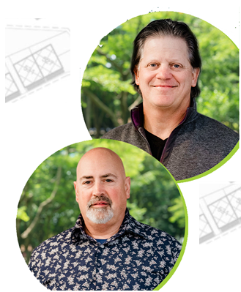



Today’s agenda
Introductions
Webinar series recap
What are the ALTA standards and why are they important?
ALTA/NSPS Standards vs Table A items – What’s the difference?
New Standard effective February 23, 2025 – What’s changed?
Q&A
SPEAKERS
Wendell
Sommers
Brent
Oswald
Jack Shoemaker
Andrew
Moncrief
© 2025 CREtelligent Inc.

Slide 3
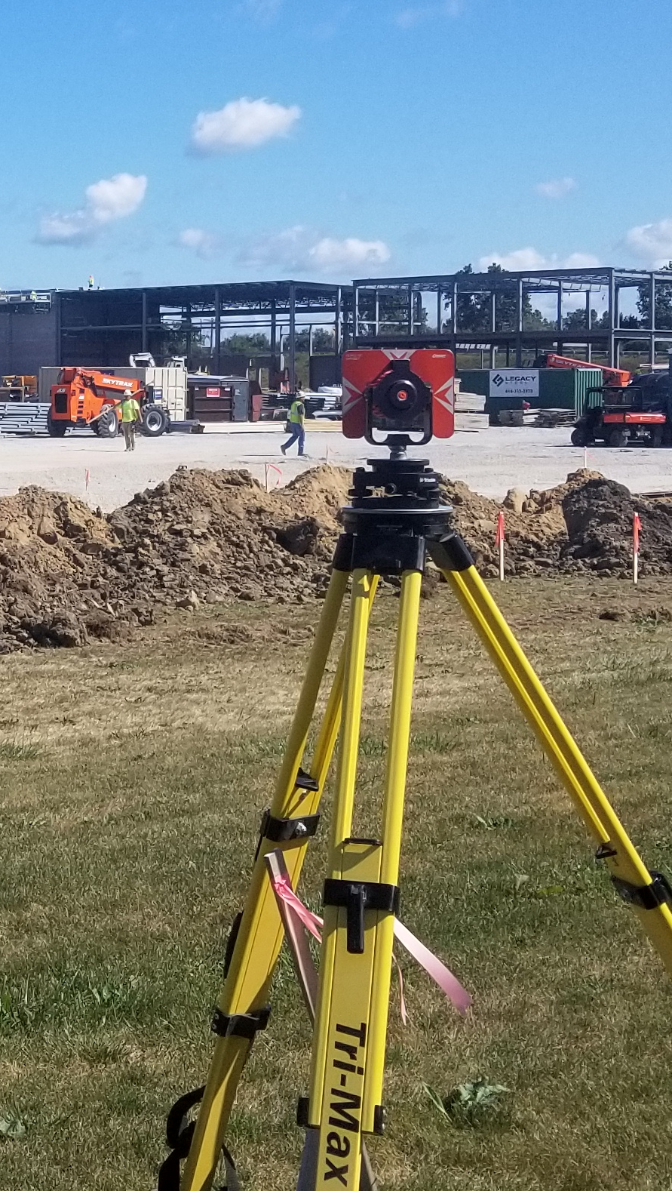
Recap – Previous Webinars
Part I: ALTA/NSPS 101 – What is a survey; why do we need them?
    Topics:
    Understanding the purpose and scope of your project
Lender and title considerations
Engineering vs Transactional surveys
Collecting necessary prior due diligence
Timing and expectations
© 2025 CREtelligent Inc.

Slide 4
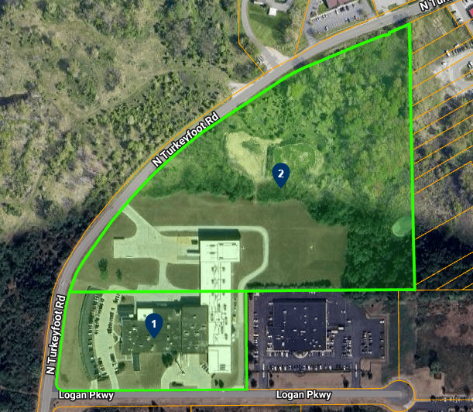
Recap – Previous Webinars
Part II: Parcel identification for ALTA Surveys
    Topics:
    Why do commercial properties have more than one parcel?
    Locating the primary parcel
    How to locate incorrect addresses or no addresses
    Determining secondary parcels
    Beneficial easements
We’ll share a recording of our first two sessions in our follow-up email!
© 2025 CREtelligent Inc.

Slide 5


What are ALTA survey standards?
What are ALTA survey standards?
ALTA/NSPS jointly develop minimum requirements
Every 5 years these are revised (2011, 2016, 2021 and 2026)
This does not cover everything!
Engineering grade surveys are a great example where
further refinements are needed
Surveyors still have opinions - Schedule B notes

Slide 6
Standards vs Table A
Understanding the difference: Standard requirements vs Table A items
Minimum elements for every ALTA Survey
    a) Researching title documents and easements
    b) Fieldwork to locate boundaries, improvements, and observed utilities
    c) Depicting certain features
    d) Providing a specific certification.
    Table A-options
      a) Many transaction grade surveys include some items “standard”
      b) Addressing zoning is actually not standard
      You will receive a copy of the standard requirements and the updated table after this meeting.

Slide 7
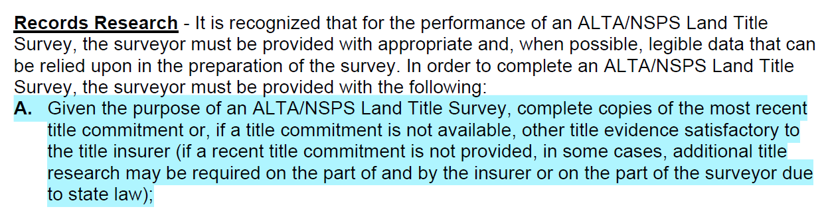

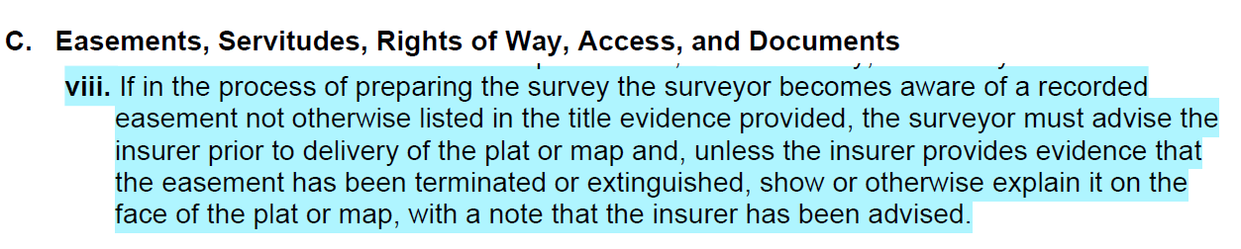
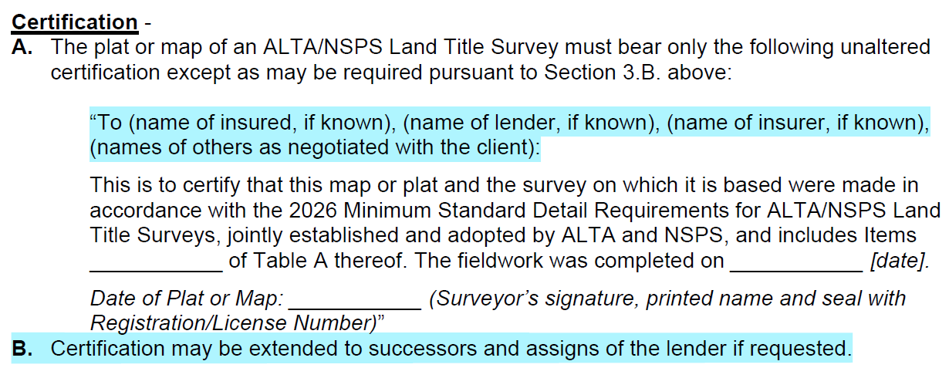
ALTA Standards – What’s changed?
Records Research and Title Commitments
              Evidence of Easements not Recorded
Certifications

Slide 8
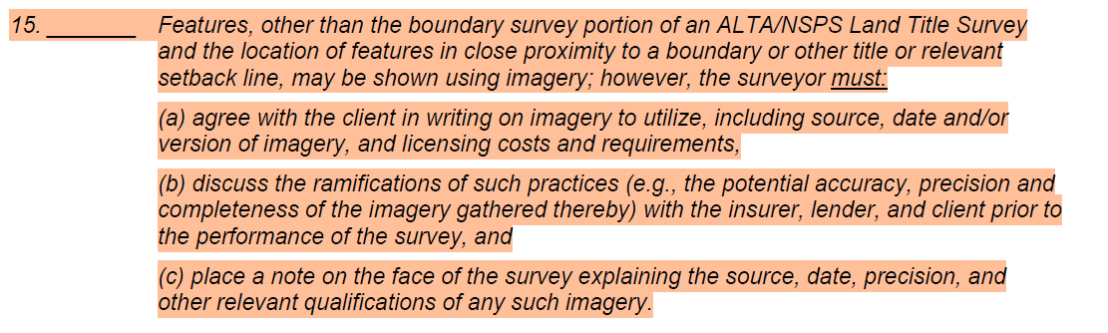
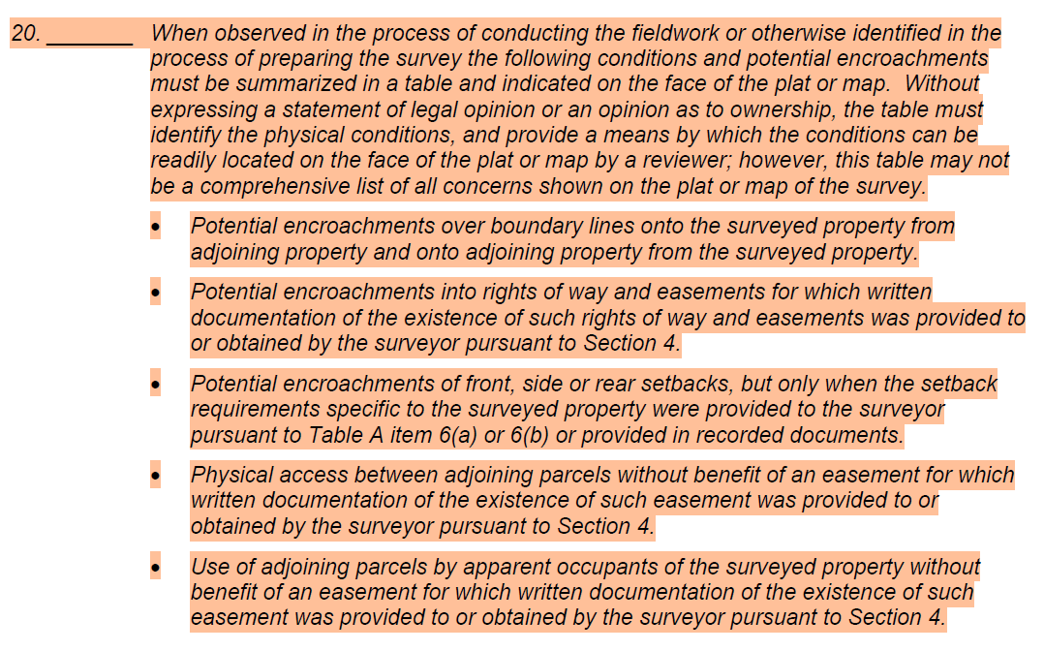
What’s changed?
Table A Items
# 15 – Documenting Features
New Item #20 – Encroachments
  Old Item #20 now Item #21 (optional items)

Slide 9
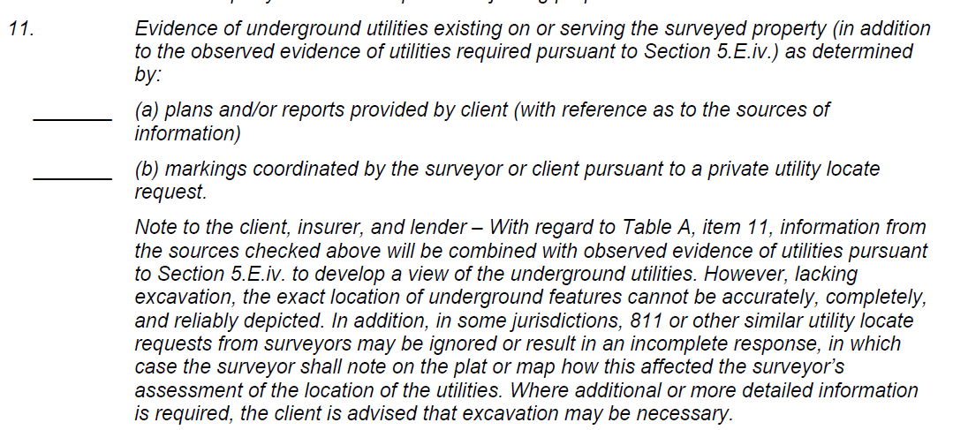
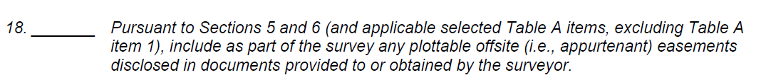
Other ‘Table A’ FAQs
Table Item #11 A&B – Utilities
Table Item #18 - Plottable offsite easements

Slide 10


QUESTIONS?
Watch for our upcoming webinar:
March: Breaking down an ALTA Survey-How do I make sense of it?
© 2025 CREtelligent Inc.

Slide 11

b.oswald@cretelligent.com
w.sommers@cretelligent.com
www.cretelligent.com 866.901.1702

